Slide 1
Detector Physics
Scintillation Detectors
GAPS Postdoc Lecture Series – November 16, 2015
D. Lascar | Postdoctoral Fellow | TRIUMF

Slide 2
Outline
Scintillation Detectors
Organic v. inorganic crystals
Detection efficiency
Light output response
Photomultiplier Tubes
Photocathodes
Electron optics
Charge multiplication/dynodes

Slide 3
From semiconductors to scintillators
Similarities:
Takes advantage of the increased density of crystal lattices
Makes use of band gap energies
Doping lowers the energy required for a measureable interaction
Differences:
Whereas scintillators re-radiate the energy absorbed as photons, semiconductors “move” electrons.

Slide 4
Scintillators
Ionizing radiation ionizes and/or excites the matter it passes through.
When the excited matter returns to g.s. in some materials γ’s are in the visible range.
Radioluminesence
The most efficient materials for visible γ generation are called scintillators.
If light emission continues for > 1 ms
Phosphor
Notes:
Phosphors are normally used as a thin layer coating the surface of a clear substrate.

Slide 5
Energy Collection
Counters need only note that some energy was collected.
For calorimetery the goal is to convert the incident energy to a proportional amount of light.
Losses from shower photons
Losses from fluorescence x-rays
Slide courtesy of M. Fortner, N. Illinois University

Slide 6
Photon Statistics
Typical Problem
Gamma rays at 450 keV are absorbed with 12% efficiency. Scintillator photons with average 2.8 eV produce photoelectrons 15% of the time.
What is the energy to produce a measurable photoelectron?
How does this compare to a gas detector (W-value)?
Answer
The total energy of scintillation is 450 x 0.12 = 54 keV.
5.4 x 10⁴ / 2.8 = 1.93 x 10⁴ photons produced
1.93 x 10⁴ x 0.15 = 2900 photoelectrons produced
The equivalent W-value for the scintillator is:
450 keV/2900 = 155 eV/pe
W-value in gas = 30 eV/ip
Slide courtesy of M. Fortner, N. Illinois University

Slide 7
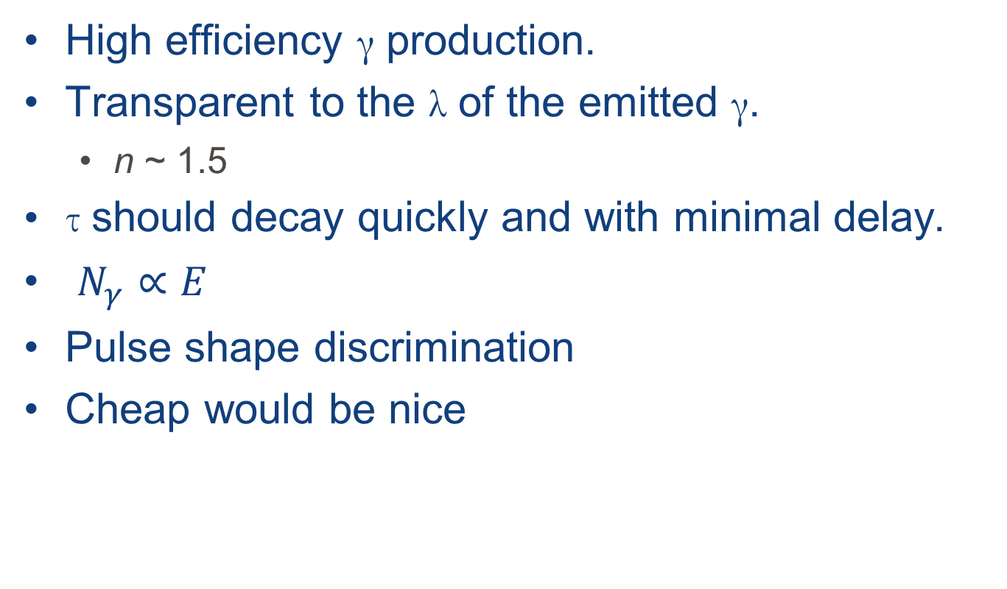
Good Scintillator Requirements
High efficiency γ production.
Transparent to the λ of the emitted γ.
n ~ 1.5
τ should decay quickly and with minimal delay.
$N_{γ}∝E$
Pulse shape discrimination
Cheap would be nice
Notes:
Will go over pulse shape discrimination later

Slide 8
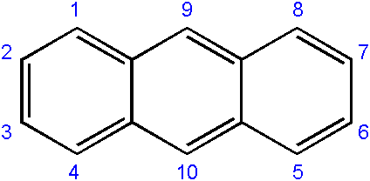
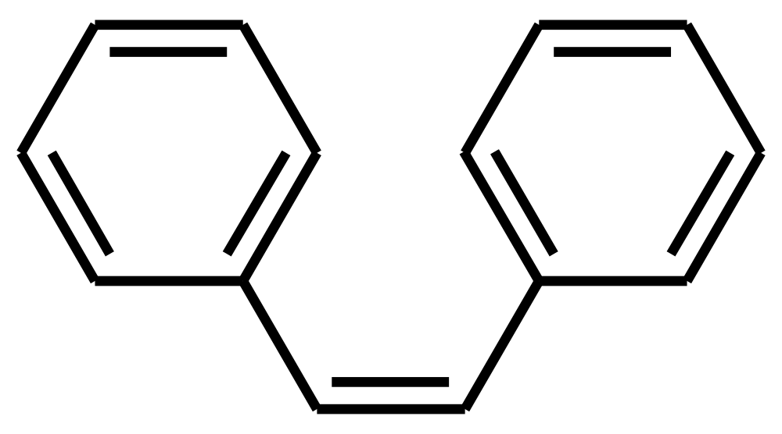
Organic Scintillators
Anthracene
Made of linked or condensed benzene structures.
Tend to be expensive.
Liquid scintillator made by dissolving material in solvent
Plastic scintillators radiate UV
Cheaper
Wavelength shifters (flour) required
https://en.wikipedia.org/wiki/Anthracene
Stilbene
https://en.wikipedia.org/wiki/(Z)-Stilbene
Notes:
Anthracene and Stilbene are just two examples
In a plastic, the mean free path of the UV photon is only a few mm
Flour added at ~1% level to absorb UV photons and re-emit at longer wavelength (lower frequency)

Slide 9
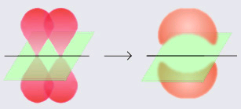
Pi-Bonds
Carbon in molecules has one excited electron.
G.S. 1s²2s²2p²
Excited 1s²2s¹2p³
Hybrid p-orbitals are π-orbitals.
Overlapping π-orbitals form bonds
Appears in double bonds
Slide courtesy of M. Fortner, N. Illinois University

Slide 10
Organic scintillator response
NE-102
Above 125 keV e⁻ response is linear
Proton/heavy particle always has a lower response
MeV electrons equivalent (MeVee)
1 MeV e⁻ → 1 MeVee
>2 MeV p → 1 MeVee
Scintillator response (arb units)
Particle Energy (MeV)
Notes:
NE-102 is a plastic scintillator
Scintillator response differs by particle type and energy
Proton/heavy particle response begins an order of magnitude lower but that gap decreases

Slide 11
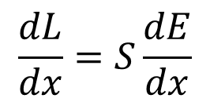
Organic scintillator response
$$\frac{dL}{dx}=S\frac{dE}{dx}$$
Flourescent energy/unit path length
Energy loss/unit path length
Normal scintillation efficiency
Notes:
Physicist from Glascow, JB Birks suggested that high ionization density along particle track leads to quenching from damage molecules.
Damage leads to decreased efficiency.

Slide 12
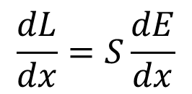
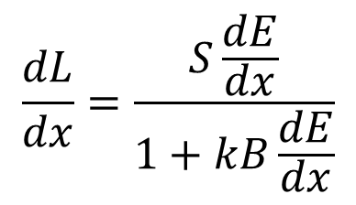
Organic scintillator response
$$\frac{dL}{dx}=S\frac{dE}{dx}$$
To account for the probability of quenching:
Normalization parameter
$$\frac{dL}{dx}=\frac{S\frac{dE}{dx}}{1+kB\frac{dE}{dx}}$$
Birk’s formula
Experimentally derived
Notes:
If we assume that damage $∝$ ionization density then density becomes $B({dE}/{dx})$
$B$ is a proportionality constant
Some fraction, $k$, of the density becomes damaged
$kB$ is experimentally derived by fitting to data

Slide 13
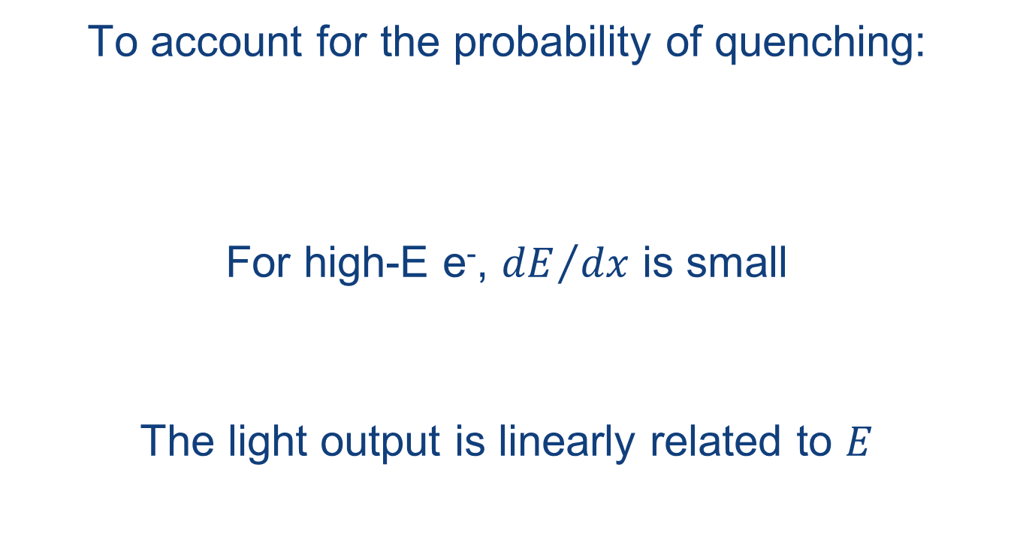
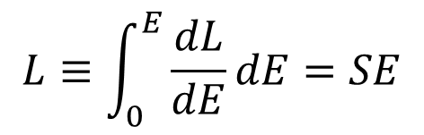
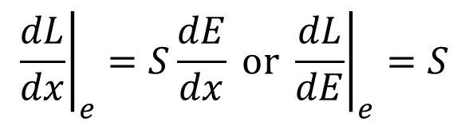
Organic scintillator response - electrons
$$\frac{dL}{dx}=S\frac{dE}{dx}$$
To account for the probability of quenching:
For high-E e⁻, ${dE}/{dx}$ is small
The light output is linearly related to $E$
$$\frac{dL}{dx}=\frac{S\frac{dE}{dx}}{1+kB\frac{dE}{dx}}$$
$${\left.\frac{dL}{dx}\right|}_{e}=S\frac{dE}{dx} \text{or} {\left.\frac{dL}{dE}\right|}_{e}=S$$
$$L≡\int_{0}^{E}{\frac{dL}{dE}dE}=SE$$

Slide 14
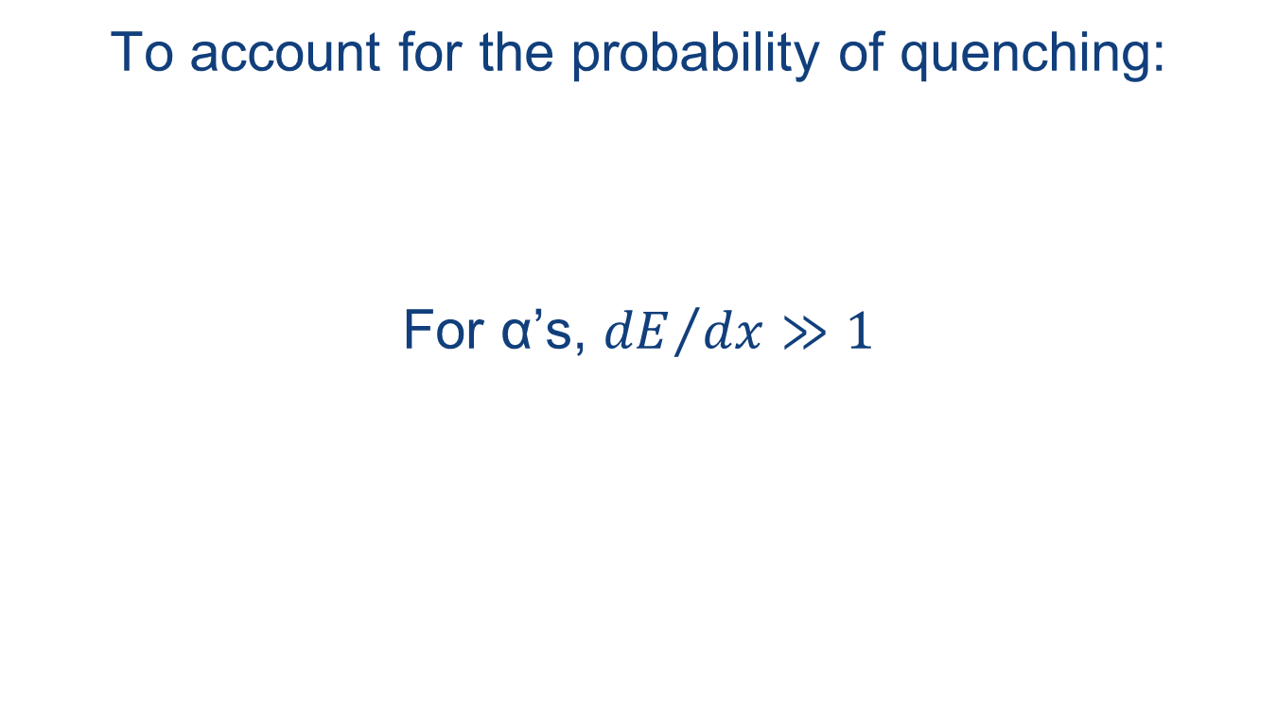
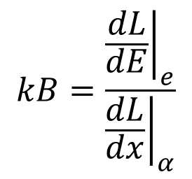
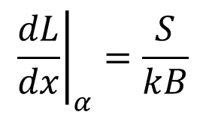
Organic scintillator response – α’s
$$\frac{dL}{dx}=S\frac{dE}{dx}$$
To account for the probability of quenching:
For α’s, ${dE}/{dx}≫1$
$$\frac{dL}{dx}=\frac{S\frac{dE}{dx}}{1+kB\frac{dE}{dx}}$$
$${\left.\frac{dL}{dx}\right|}_{α}=\frac{S}{kB}$$
$$kB=\frac{{\left.\frac{dL}{dE}\right|}_{e}}{{\left.\frac{dL}{dx}\right|}_{α}}$$

Slide 15
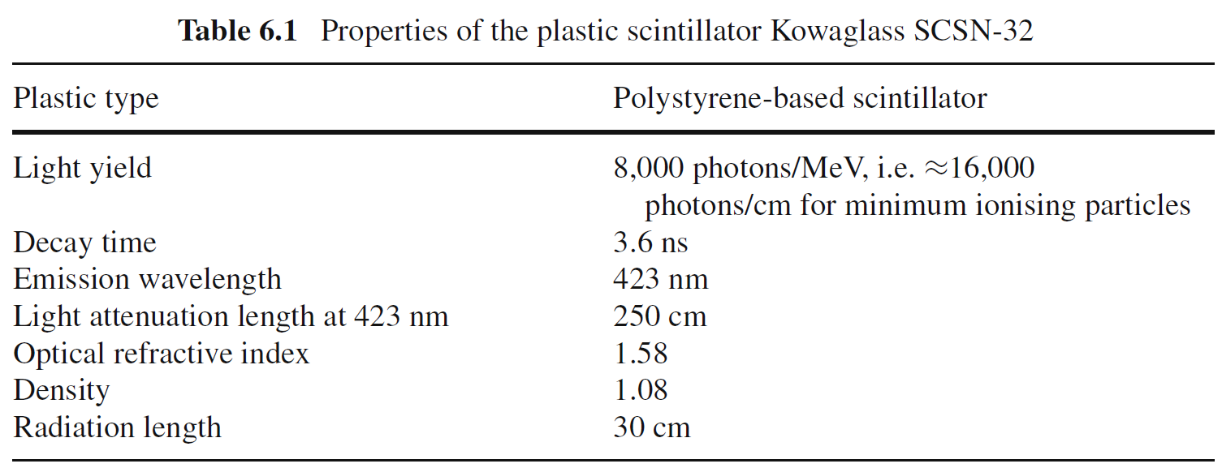
Organic Scintillators
Notes:
Anthracene and Stilbene are just two examples
In a plastic, the mean free path of the UV photon is only a few mm
Flour added at ~1% level to absorb UV photons and re-emit at longer wavelength (lower frequency)

Slide 16
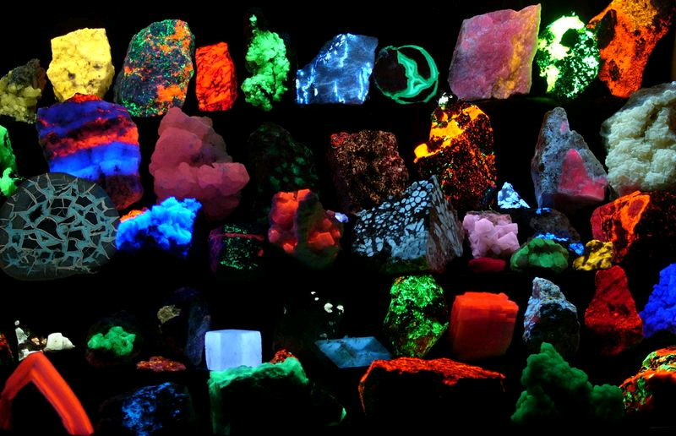
Inorganic Scintillators
Fluorescence is known in many natural crystals.
UV light absorbed
Visible light emitted
Artificial scintillators can be made from many crystals.
Doping impurities added
Improve visible light emission
Higher density = More interaction = More efficient
Slide courtesy of M. Fortner, N. Illinois University

Slide 17
Band Structure
Impurities in the crystal provide energy levels in the band gap.
Charged particles excites electrons to states below the conduction band.
De-excitation causes photon emission.
Crystal is transparent at photon frequency.
conduction band
impurity excited states
hν
impurity ground state
valence band
Slide courtesy of M. Fortner, N. Illinois University

Slide 18
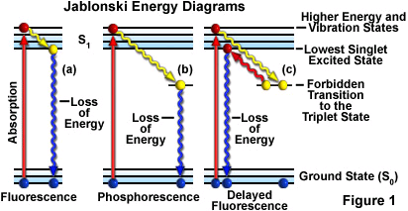
Jablonski Diagram
Jablonski diagrams characterize the energy levels of the excited states.
Vibrational transitions are low frequency
Fluorescence and phosphorescence are visible and UV
Transitions are characterized by a peak wavelength λ_{max}.
Slide courtesy of M. Fortner, N. Illinois University

Slide 19
Time Lag
Fluorescence typically involves three steps.
Excitation to higher energy state.
E loss through change in vibrational state
Emission of fluorescent photon.
The time for 1/e of the atoms to remain excited is the characteristic time τ.
10⁻¹² s
S₁
10⁻¹⁵ s
10⁻⁷ s
S₀
Slide courtesy of M. Fortner, N. Illinois University

Slide 20
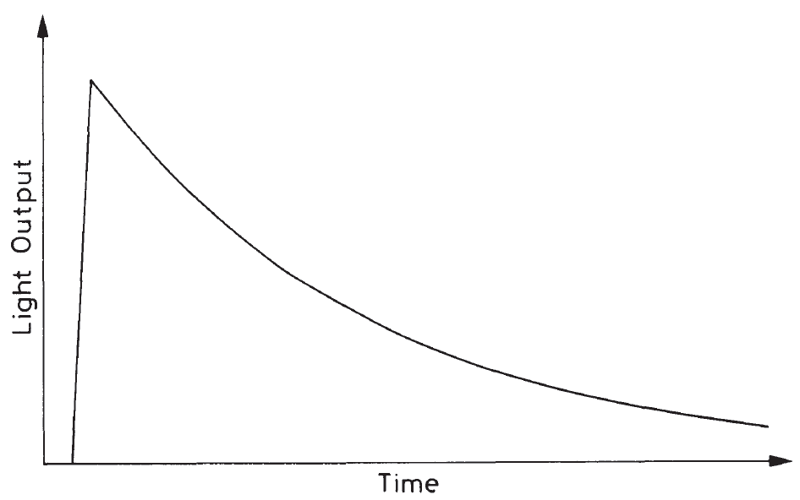
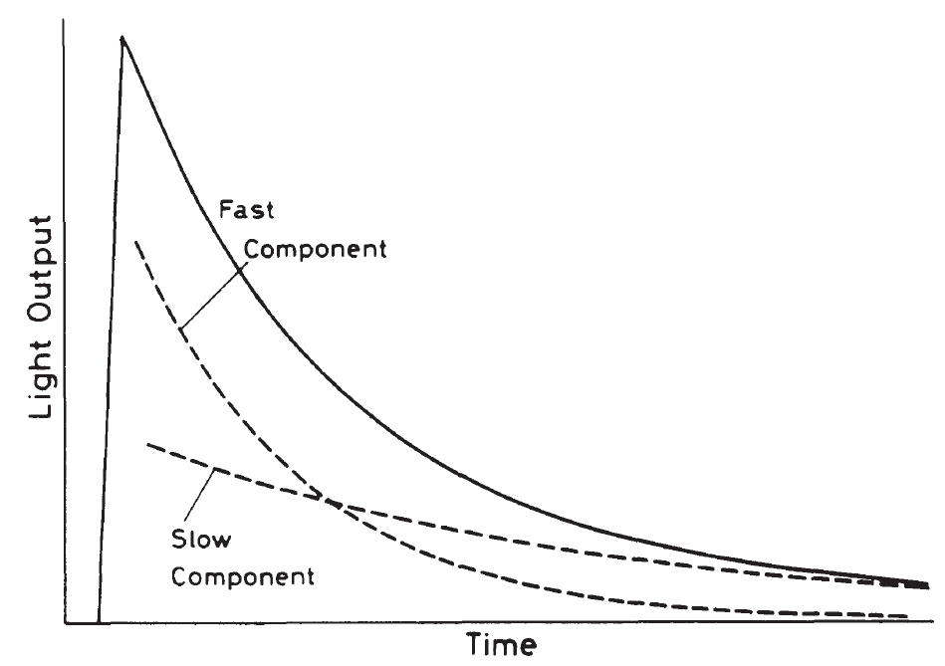
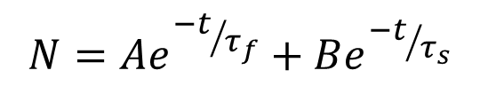
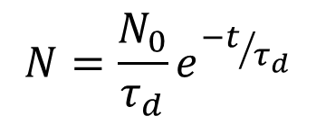
Decay Constant (τ_{d})
$$N=\frac{N_{0}}{τ_{d}}e^{{−t}/{τ_{d}}}$$
$$N=Ae^{{−t}/{τ_{f}}}+Be^{{−t}/{τ_{s}}}$$
Notes:
N is the number of photons emitted in time, t.
N₀ is the total number of photons emitted.

Slide 21
Crystal Specs
Common crystals are based on alkali halides
Thallium or sodium impurities
Fluorite (CaF₂) is a natural mineral scintillator.
(BGO, Bi₄Ge₃O₁₂) is popular in physics detectors.
Crystal | τ (ns) | λ_{max} (nm) | Output (nm)
Na(Tl) | 250 | 415 | 100
CsI(Tl) | 1000 | 550 | 45
CsI | 16 | 315 | 5
ZnS(Ag) | 130 | 110 | 450
CaF₂(Eu) | 930 | 435 | 50
BGO | 300 | 480 | 20
www.detectors.saint-gobain.com
Slide courtesy of M. Fortner, N. Illinois University
Notes:
BGO is Bismuth germanate

Slide 22
What can we do with photons
The radiation that interacts with the scintillator generates photons.
We can’t count photons.
We can manipulate them.
Light guides can reflect and transmit photons at near 100% efficiency.
We can send them into materials to generate predictable behavior.
Photocathodes

Slide 23
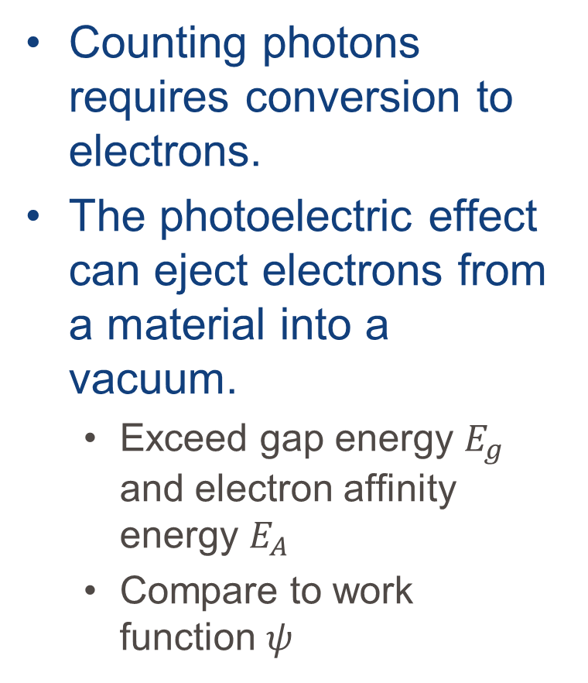
Photoelectron Emission
Counting photons requires conversion to electrons.
The photoelectric effect can eject electrons from a material into a vacuum.
Exceed gap energy $E_{g}$ and electron affinity energy $E_{A}$
Compare to work function $ψ$
vacuum energy
e⁻
E_{A}
conduction band
ψ
Fermi energy
hν
E_{G}
valence band
Slide courtesy of M. Fortner, N. Illinois University

Slide 24
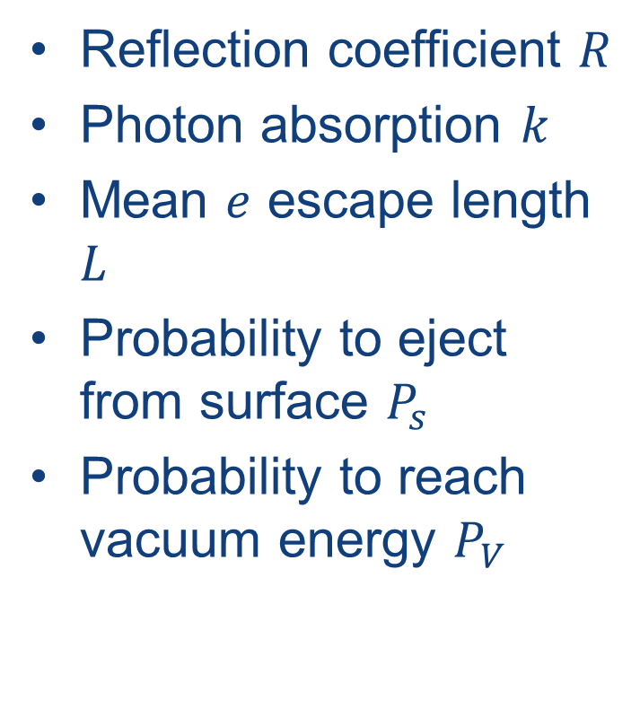
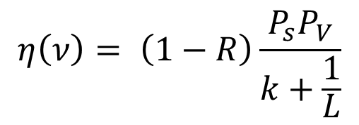
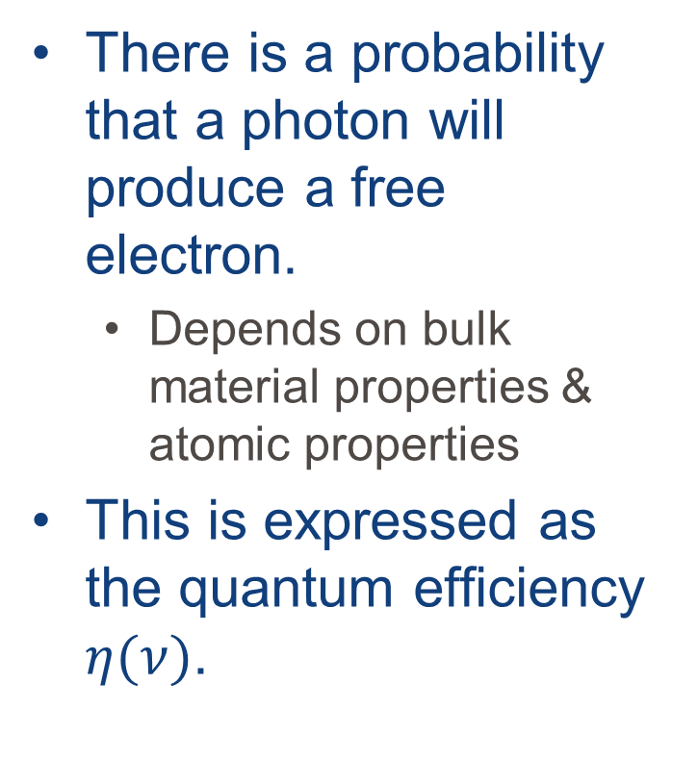
Quantum Efficiency
There is a probability that a photon will produce a free electron.
Depends on bulk material properties & atomic properties
This is expressed as the quantum efficiency $η(ν)$.
Reflection coefficient $R$
Photon absorption $k$
Mean $e$ escape length $L$
Probability to eject from surface $P_{s}$
Probability to reach vacuum energy $P_{V}$
$$η\left(ν\right)= \left(1−R\right)\frac{P_{s}P_{V}}{k+\frac{1}{L}}$$
Slide courtesy of M. Fortner, N. Illinois University
Notes:
Photocathodes are designed to maximize the quantum efficiency.
Layer of semiconductor or alkali compound on glass.
Quantum efficiency dominated by L and P_{s}.
Thin material that passes electrons easily for L
Material with low E_{A} to improve P_{s}

Slide 25
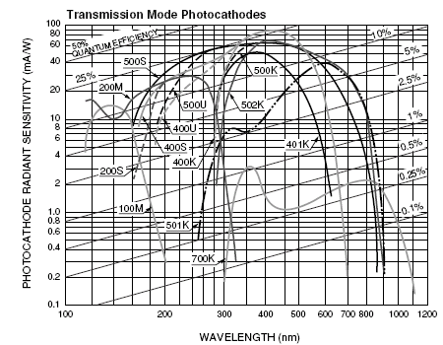
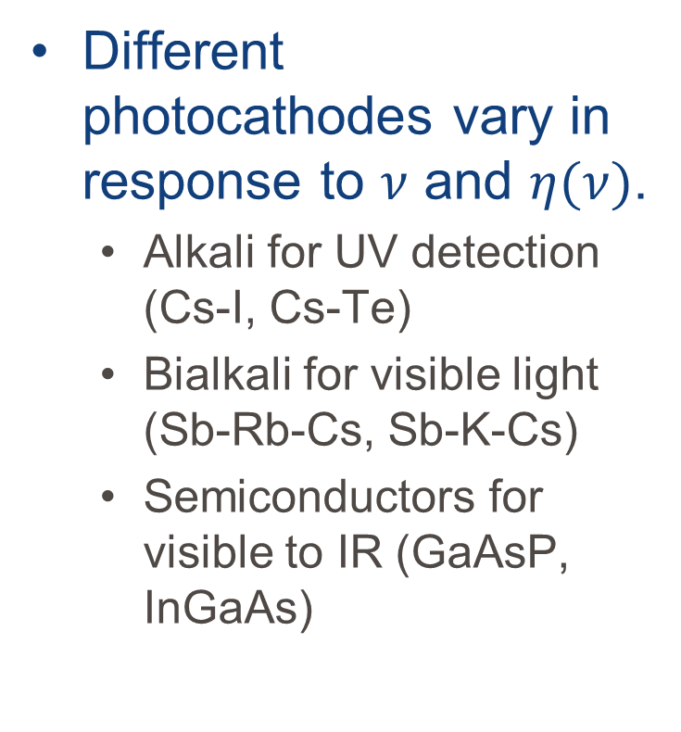
Commercial Photocathodes
Different photocathodes vary in response to $ν$ and $η(ν)$.
Alkali for UV detection (Cs-I, Cs-Te)
Bialkali for visible light (Sb-Rb-Cs, Sb-K-Cs)
Semiconductors for visible to IR (GaAsP, InGaAs)
Hamamatsu.com
Slide courtesy of M. Fortner, N. Illinois University

Slide 26
Challenge:
i
ΔV
Single electrons are hard to detect. What to do?
Stronger Field
Gives electrons more energy
If the electrons have enough energy to ionize along their path
Constant E-field so avalanche everywhere
PPAC
arallel
late
valanche
ounter
Notes:
Remember this from the last lecture? It’s the same problem. Single electrons are hard to detect. What to do?

Slide 27
Electron Multiplier
Electrons can be multiplied by interaction with a surface.
Emitter: BeO, GaP
Metal substrate: Ni, Fe, Cu
This electrode is called a dynode.
e
emissive surface
substrate electrode

Slide 28
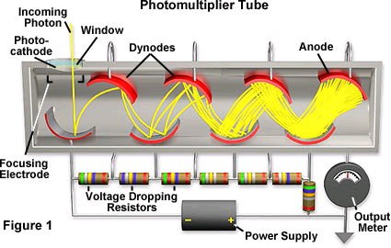
Photomultiplier Tube (PMT)
PMTs combines a photocathode and series of dynodes.
High voltage is divided between the dynodes.
Output current is measured at the anode.
Sometimes at the last dynode
Slide courtesy of M. Fortner, N. Illinois University

Slide 29
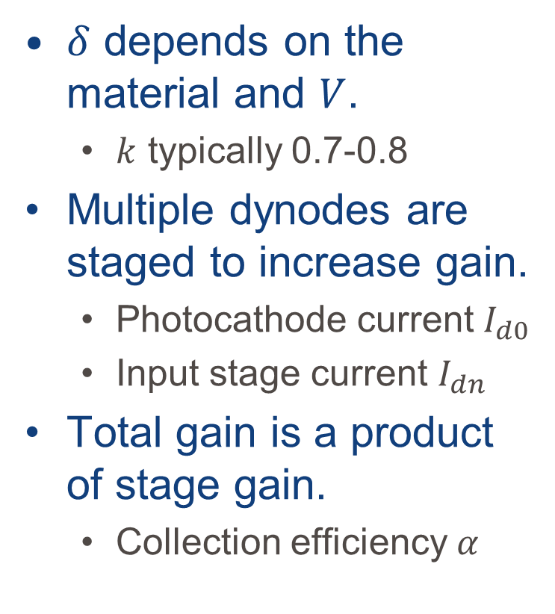

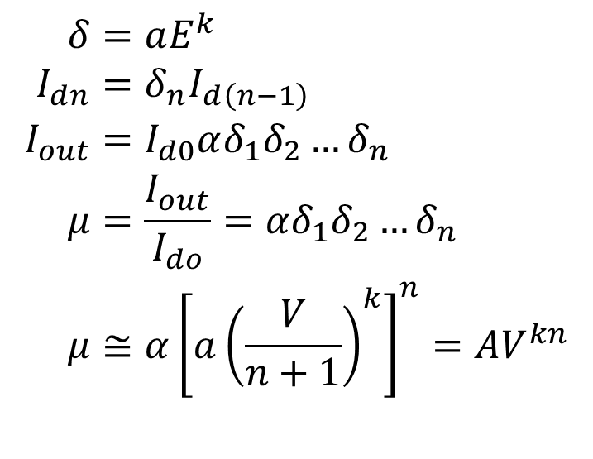
Gain ($δ$)
$δ$ depends on the material and $V$.
$k$ typically 0.7-0.8
Multiple dynodes are staged to increase gain.
Photocathode current $I_{d0}$
Input stage current $I_{dn}$
Total gain is a product of stage gain.
Collection efficiency $α$
$$\begin{aligned}δ&=aE^{k} \\ I_{dn}&=δ_{n}I_{d\left(n−1\right)} \\ I_{out}&=I_{d0}αδ_{1}δ_{2}…δ_{n} \\ μ&=\frac{I_{out}}{I_{do}}=αδ_{1}δ_{2}…δ_{n} \\ μ&≅α{\left[a{\left(\frac{V}{n+1}\right)}^{k}\right]}^{n}=AV^{kn}\end{aligned}$$
Slide courtesy of M. Fortner, N. Illinois University

Slide 30
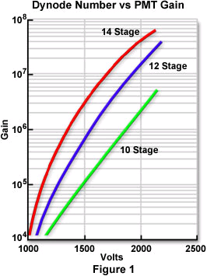
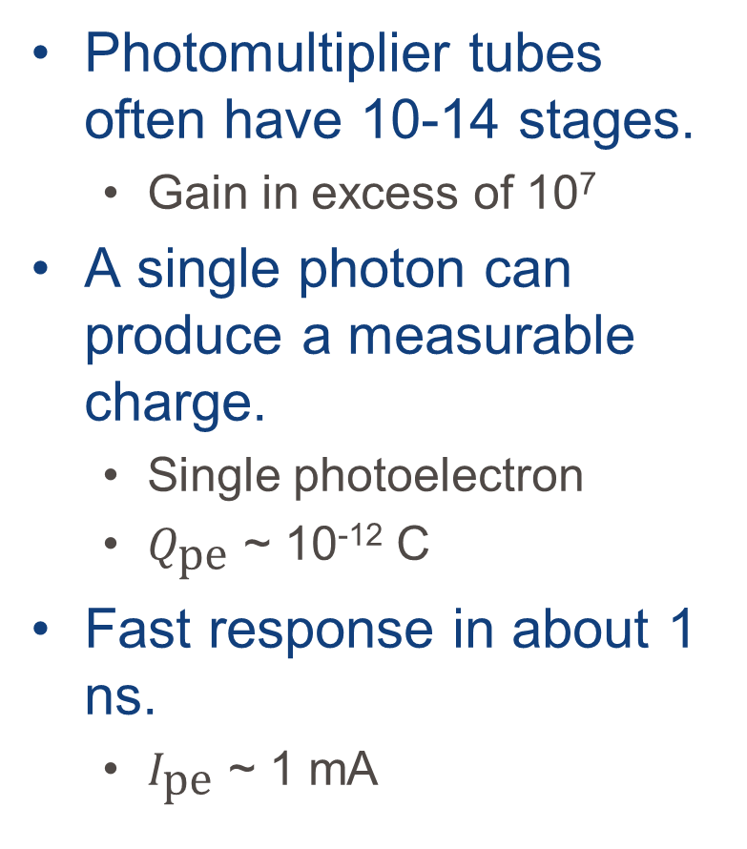
Amplifier
Photomultiplier tubes often have 10-14 stages.
Gain in excess of 10⁷
A single photon can produce a measurable charge.
Single photoelectron
$Q_{\text{pe}}$ ~ 10⁻¹² C
Fast response in about 1 ns.
$I_{\text{pe}}$ ~ 1 mA
Slide courtesy of M. Fortner, N. Illinois University

Slide 31
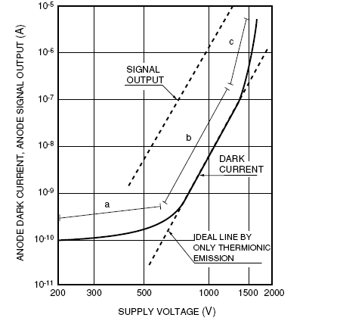
Dark Current
Phototubes have “dark” current even with no incident light.
Thermionic emission
Anode leakage
Case scintillation
Gas ionization
This increases with applied voltage.
Slide courtesy of M. Fortner, N. Illinois University

Slide 33
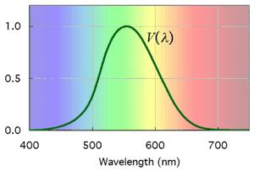
Flux
Radiant flux (W) measures the energy flowing at a point per unit time.
Luminous flux (lm) weights the flux for its impact on a visual system.
Peak efficiency constant K_{m} = 683 lm/W
Spectral luminous efficiency V(λ)

Slide 34
Luminous Area
The flux per unit area is the irradiance (illuminance) E.
lm/m² = lux
Flux from a luminous area is the emittance M.
Lux not used
dΦ
dΦ
dA
dA
Irradiance
Emittance

Slide 35
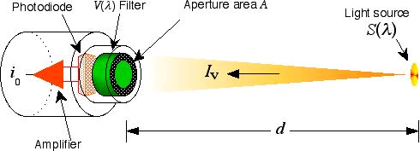
Intensity
Intensity relates to the flux from a point source.
Flux per unit solid angle
Definition of the candela
Intensity is calibrated by a current from a known source with a known response s.

Slide 36
Noise
Dark current contributes to the noise in a measurement.
Equivalent noise input
For Δf = 1 Hz, P ~ 10⁻¹⁵ W
Signal to noise depends on the statistical fluctuations, dark current and readout circuit.
Dominated by statistics
Slide courtesy of M. Fortner, N. Illinois University

Slide 37
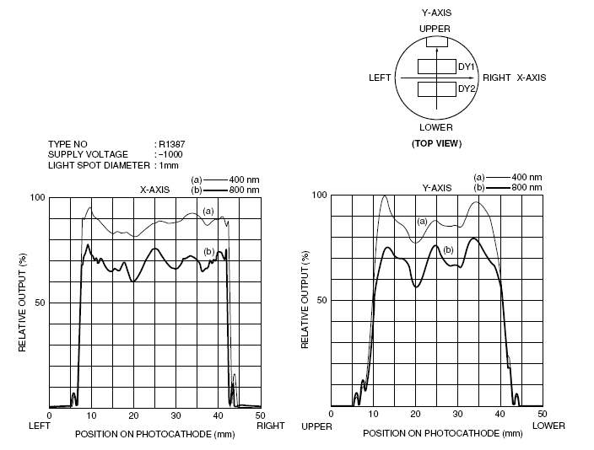
Position Response
Photocathodes are not uniform.
Variations in response on the surface.
Angular response falls off beyond 40°.

